Slide 1


CryptoCoders03
FactForge
Presented by:
Anisha Paturi
Sravani Janak
T Jayashree Indrani

Slide 2
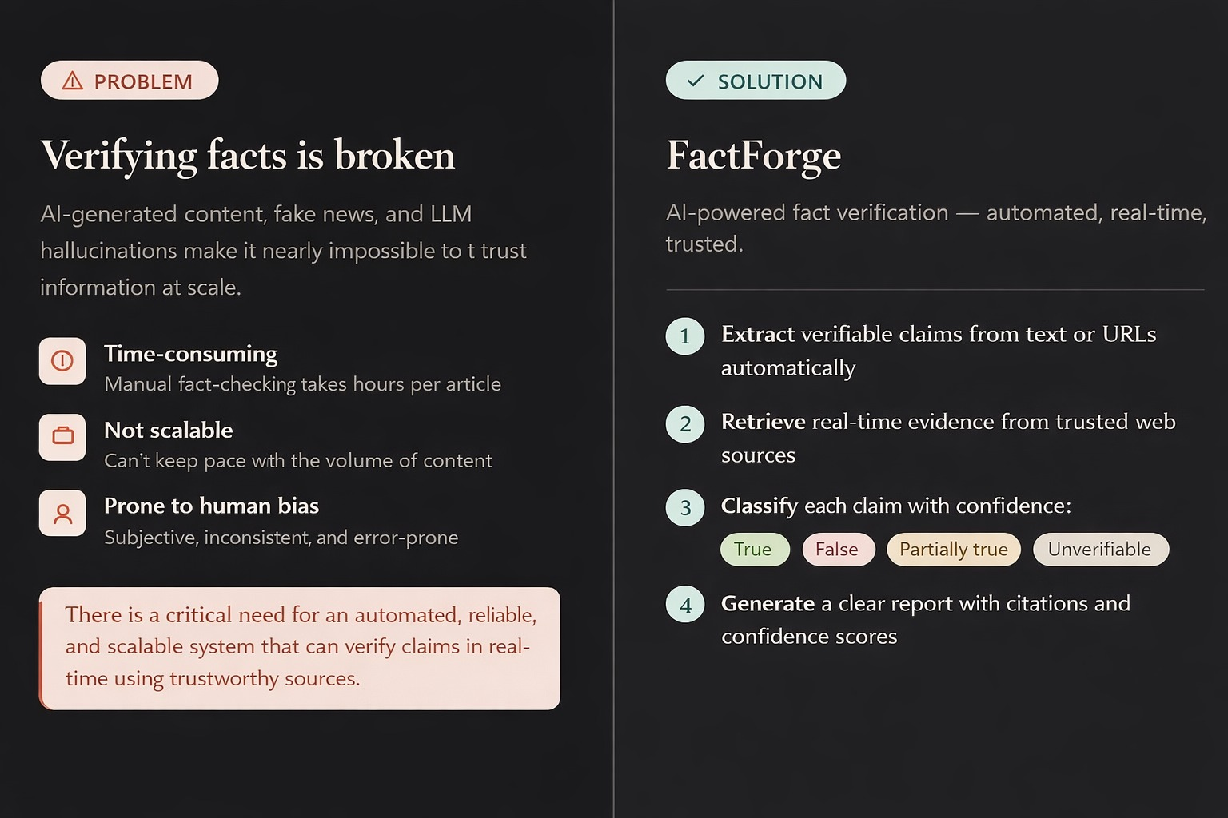

Slide 3
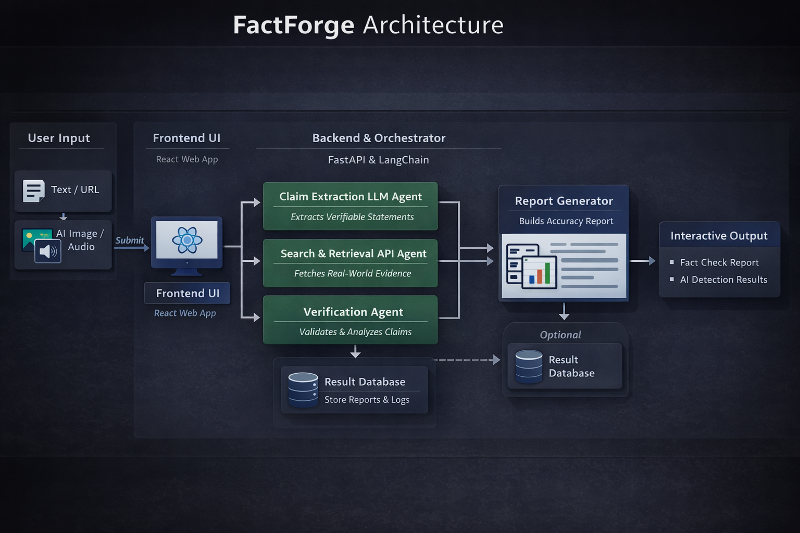
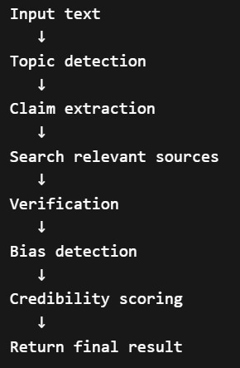
Architecture Diagram

Slide 4
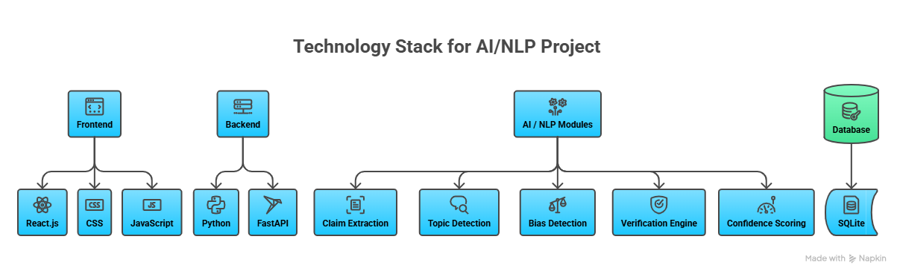
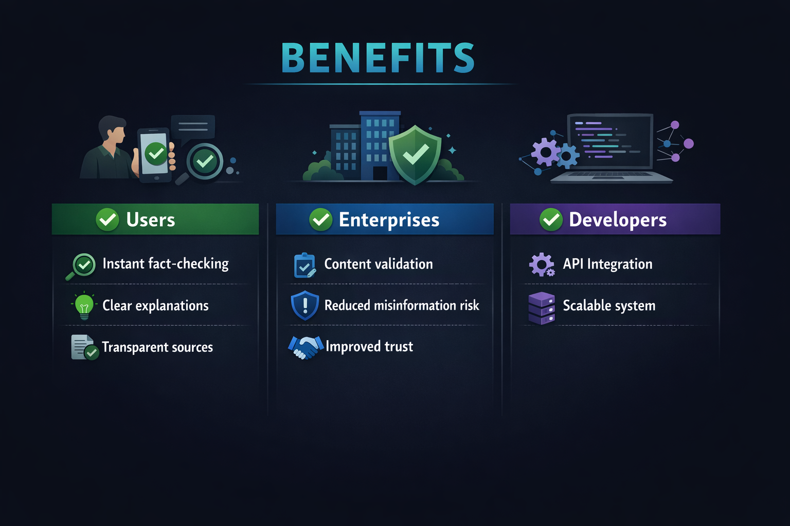
Tech Stack
Benefits

Slide 5
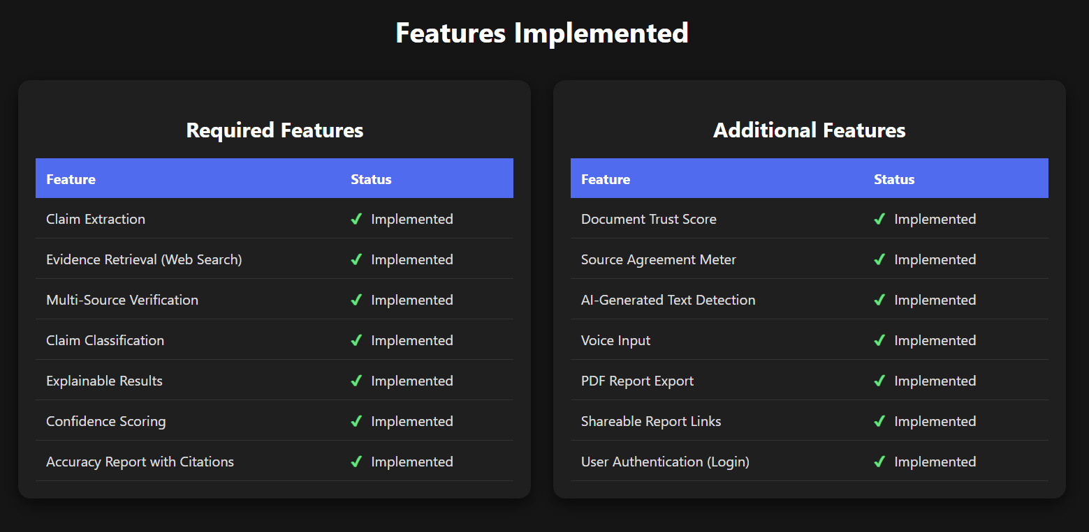
Features Implemented

Slide 6
CryptoCoders03
Thank you!

